Slide 1

WebDriver Basics Interactions & Locators
Module 3

Slide 2
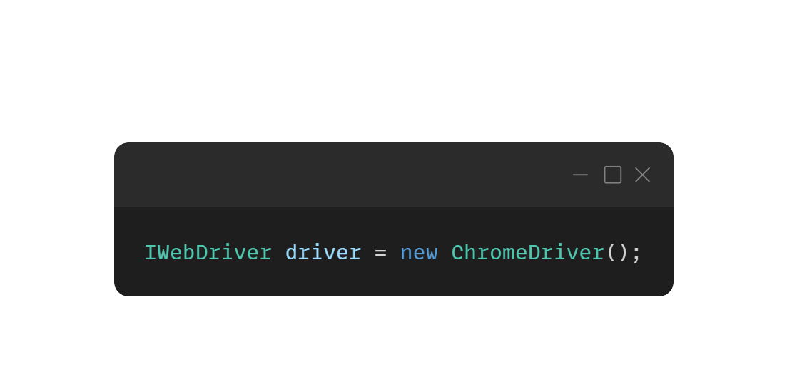
Understanding WebDriver
WebDriver is an interface that allows you to programmatically control a web browser by simulating user actions, such as navigating to web pages, interacting with web elements (buttons, forms, etc.), and extracting information from a webpage.
WebDriver interacts directly with the browser, making it faster, more reliable, and capable of working with modern web technologies.
WebDriver uses browser-specific drivers (e.g., ChromeDriver for Chrome, FirefoxDriver for Firefox) to interact with the browser. These drivers translate the commands given by the WebDriver into browser-specific commands, allowing it to perform actions like opening a page, finding elements, and interacting with them.

Slide 3
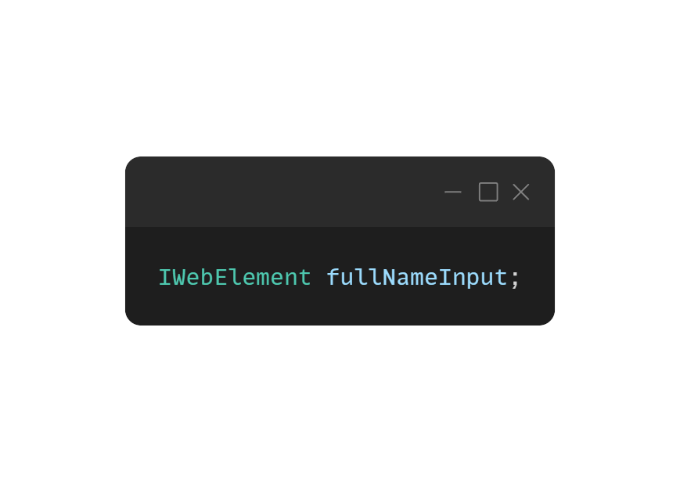
Understanding WebElements
Web elements refer to the different components or parts of a webpage that can be interacted with.
Input fields
Buttons (e.g., submit buttons, clickable links)
Links (anchors or hyperlinks)
Images (elements represented by <img>)
Dropdowns (select elements)
Divs, spans, etc. (generic HTML elements)
Tables, paragraphs, and more.

Slide 4
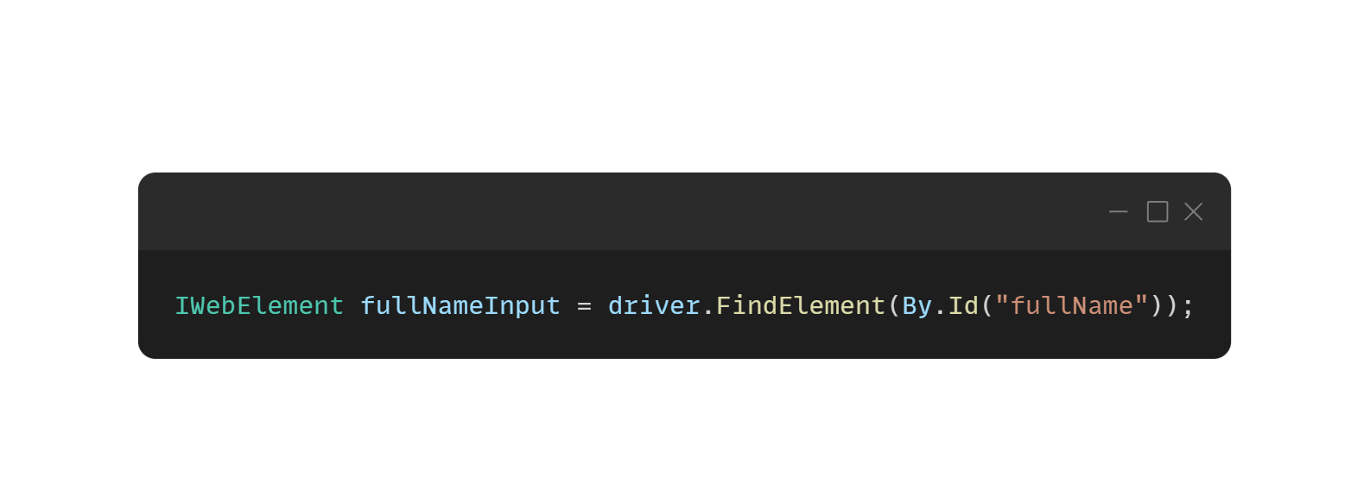
Locating Web Elements
Locators are used to find elements on a webpage.
They are essential for interacting with web elements in automated tests.
Selenium supports various types of locators, each with its own strengths and weaknesses.
ID
CSS Selectors
XPath
Name
ClassName
TagName

Slide 5
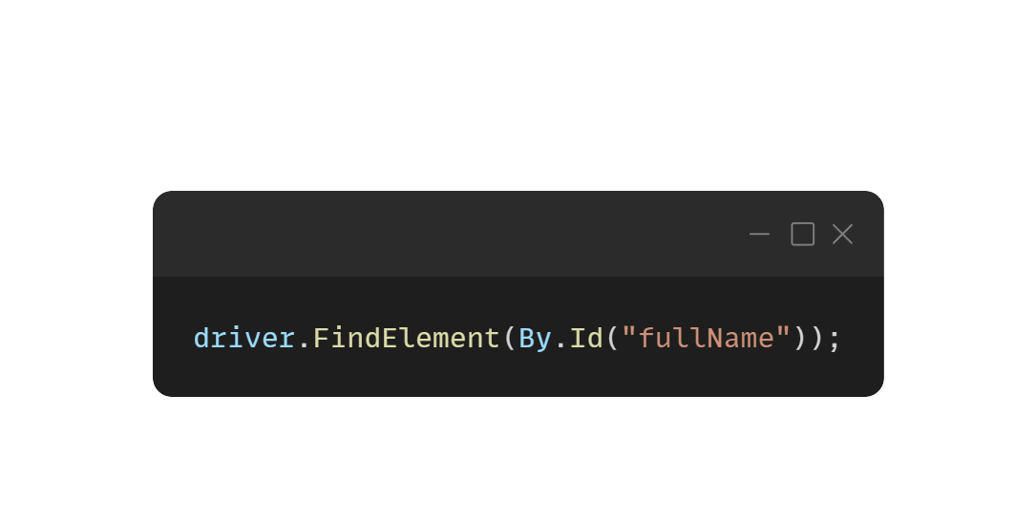
Locating Web Elements
ID Locator
Uses the unique ID of an element.
Advantages | Limitation
Fast and reliable | Not all elements have unique IDs
Unique for each element, ensuring no ambiguity

Slide 6
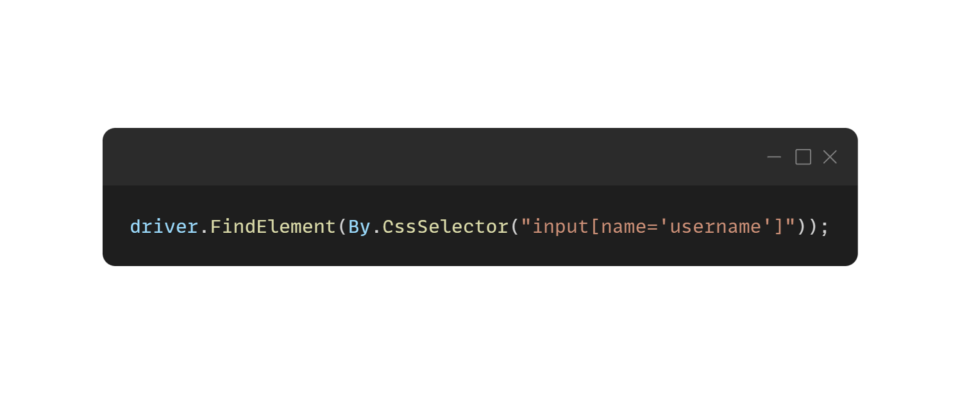
Locating Web Elements
CSS Selectors Locator
Uses CSS selectors to locate elements.
Advantages | Limitation
Very fast and efficient | Can be complex for deeply nested elements
Flexible with multiple ways to define selectors | Harder to understand and maintain for beginners

Slide 7

Locating Web Elements
XPath Locator
Uses XML path expressions to locate elements.
Advantages | Limitation
Highly flexible and powerful | Slower than other locators, especially for large documents
Can locate elements using various attributes, text, or hierarchy | Complex expressions can lead to brittle tests

Slide 8
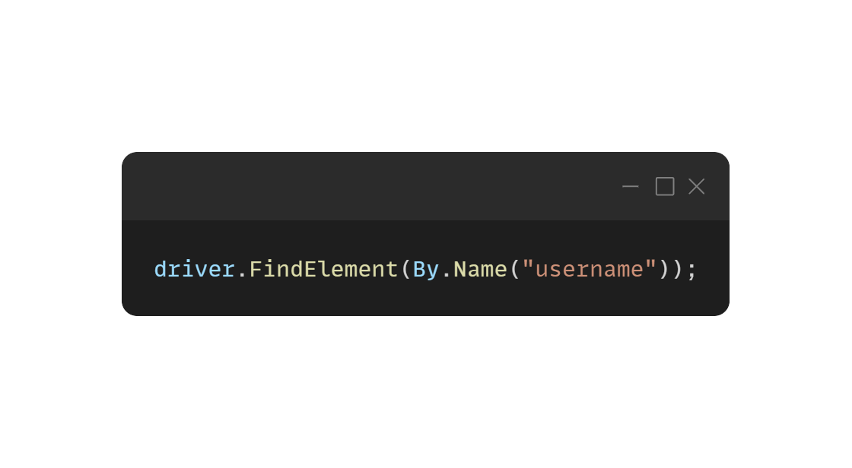
Locating Web Elements
Name Locator
Uses the name attribute of an element.
Advantages | Limitation
Often used in forms where elements have unique names | Not always unique
Simple to implement | Can be absent for some elements

Slide 9
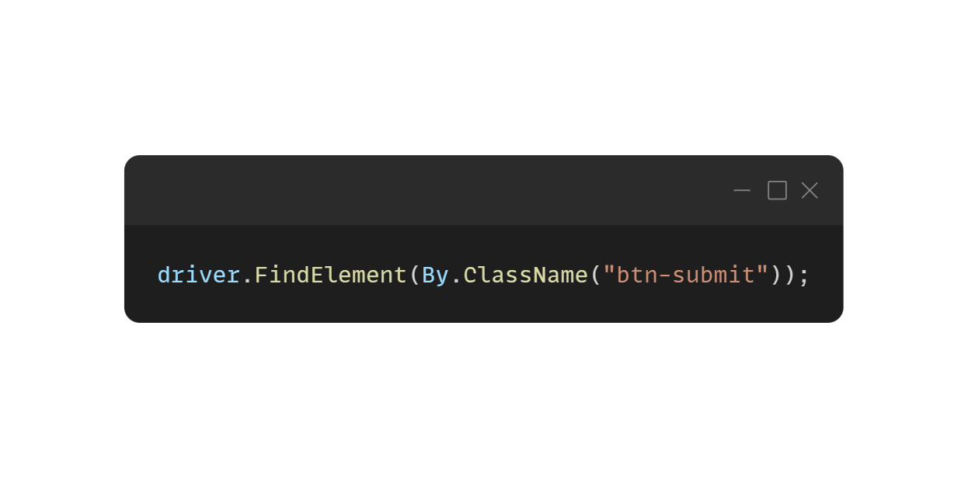
Locating Web Elements
ClassName Locator
Uses the class attribute of an element.
Advantages | Limitation
Easy to use when elements have distinctive class names | Class names may not be unique
Great for selecting multiple elements with the same class | Can be difficult to target specific elements if multiple elements share the same class

Slide 10
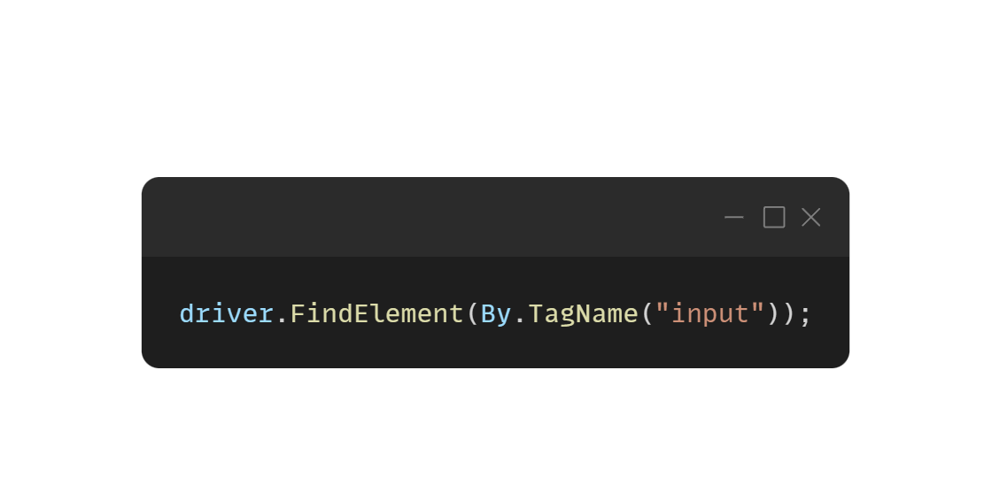
Locating Web Elements
TagName Locator
Uses the tag name of an HTML element.
Advantages | Limitation
Simple and fast when targeting multiple elements of the same tag | Not unique; multiple elements can share the same tag name
 | Less precise if the tag is too generic

Slide 11
Locating Web Elements
Useful tools in building locators
XPath cheat sheet - https://devhints.io/xpath
CssSelector cheat sheet - https://scrapfly.io/blog/css-selector-cheatsheet/

Slide 12
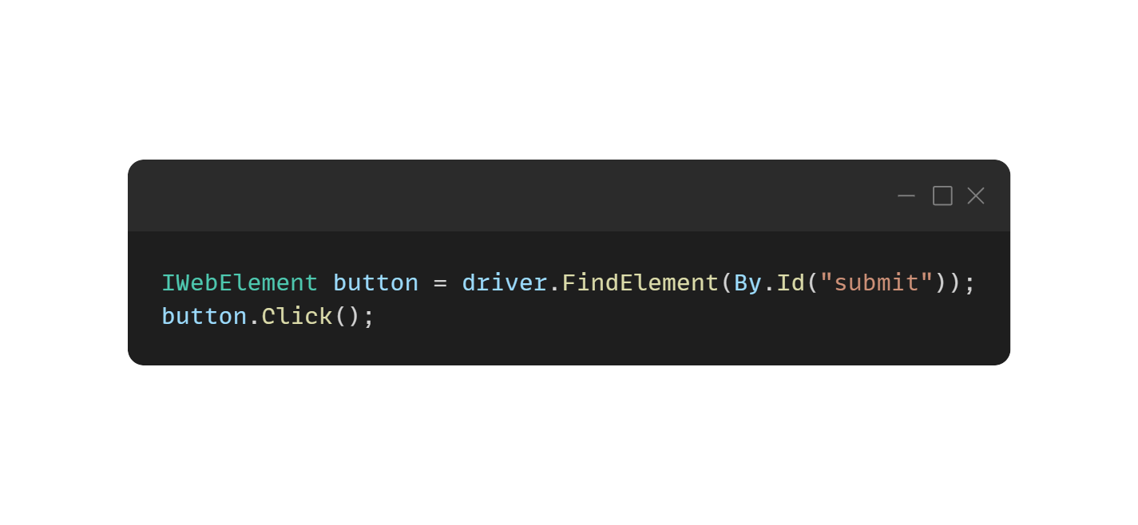
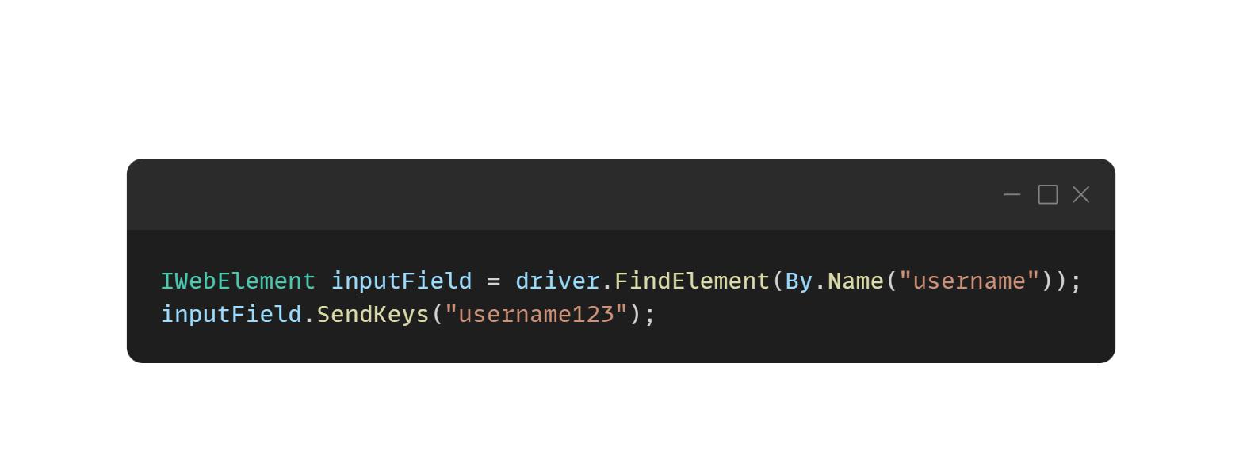
Interacting with Web Elements
Once an element is located, WebDriver can perform various actions, such as
Clicking: Clicking on buttons, links, or other clickable elements.
Sending Text: Sending keystrokes to input fields or text areas.

Slide 13
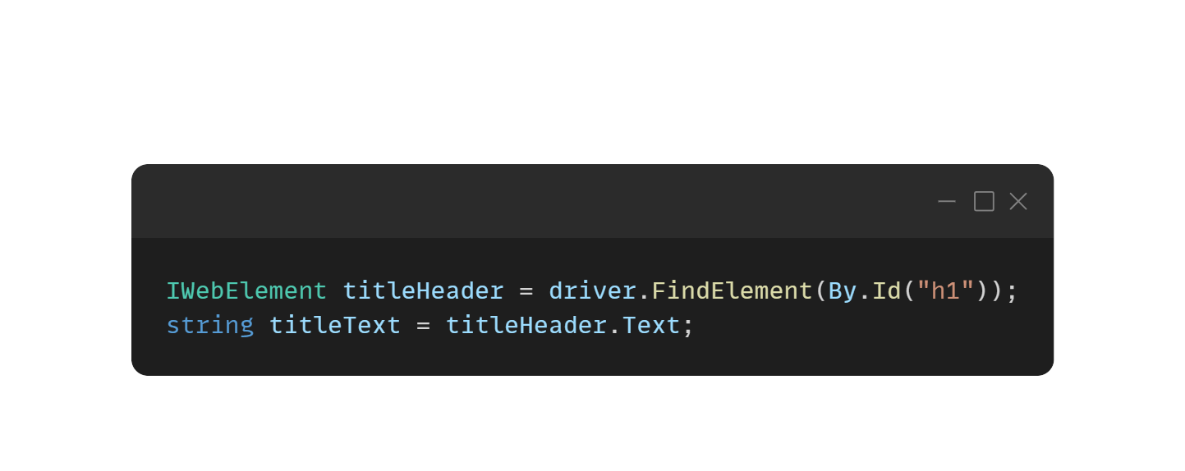
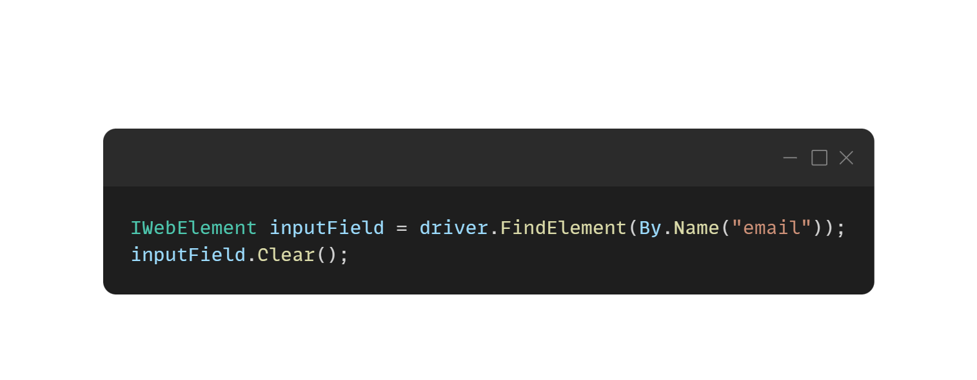
Interacting with Web Elements
Getting Text: Retrieving the text of an element.
Clearing Text: Clearing text in input fields.

Slide 14
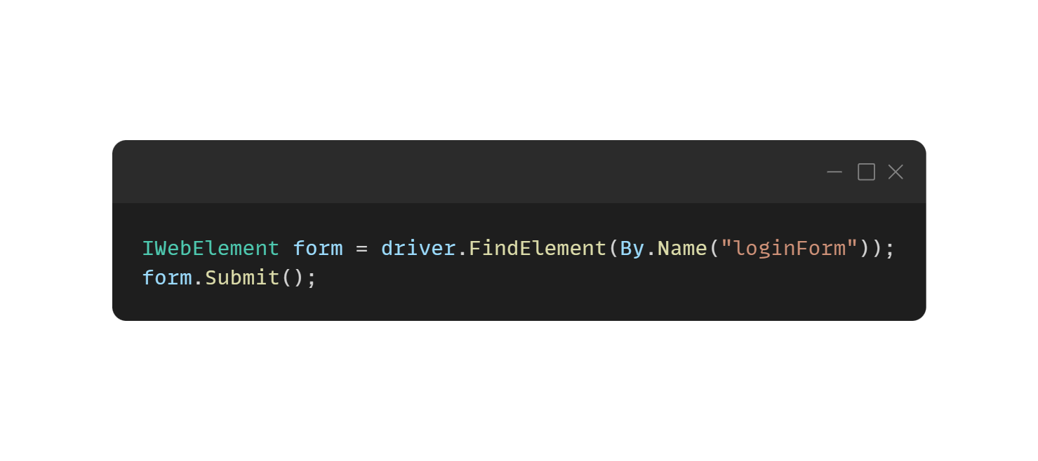
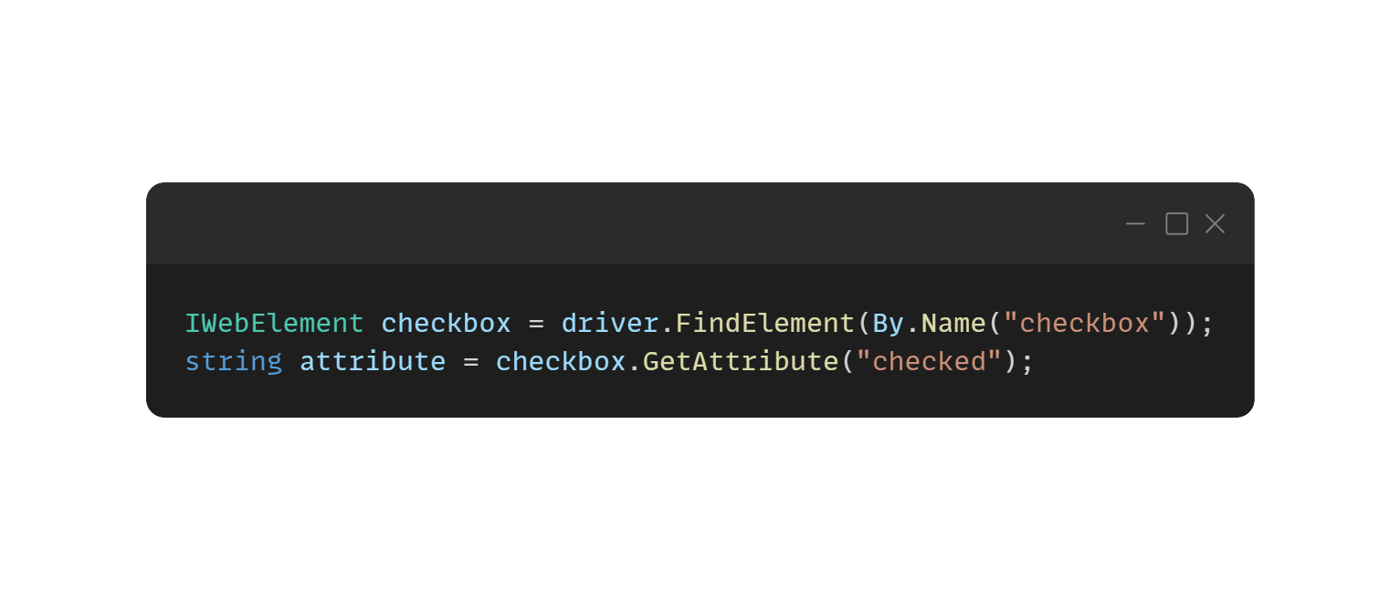
Interacting with Web Elements
Submitting Forms: Submitting forms via the submit() method (common for forms with buttons).
Getting Attributes: Accessing an element’s attributes.

Slide 15
Hands-on Activity
Create a new console project named ‘Module3’
Write a selenium script for the following Test Steps
Use combination of locator types - Id, CssSelector, XPath
Push your code to your GitHub Repo using GitHub Desktop Application

Slide 16
Test Steps
Open Chrome Browser
Navigate to URL https://www.saucedemo.com/
Input UserName {standard_user}
Input Password {secret_sauce}
Click Login Button
Click Burger Menu
Click Logout
Close Chrome Browser

